Slide 1

FOAM Lecture 4 Introduction to Machine Learning and Data Handling
Mike O’Dea
(based upon material created by Simos Gerasimou)
Check In code: 242141

Slide 2
This Lecture
Data Science Lifecycle
Exploratory Data Analysis
Handling Missing Data
Identifying and Handling Outliers

Slide 3
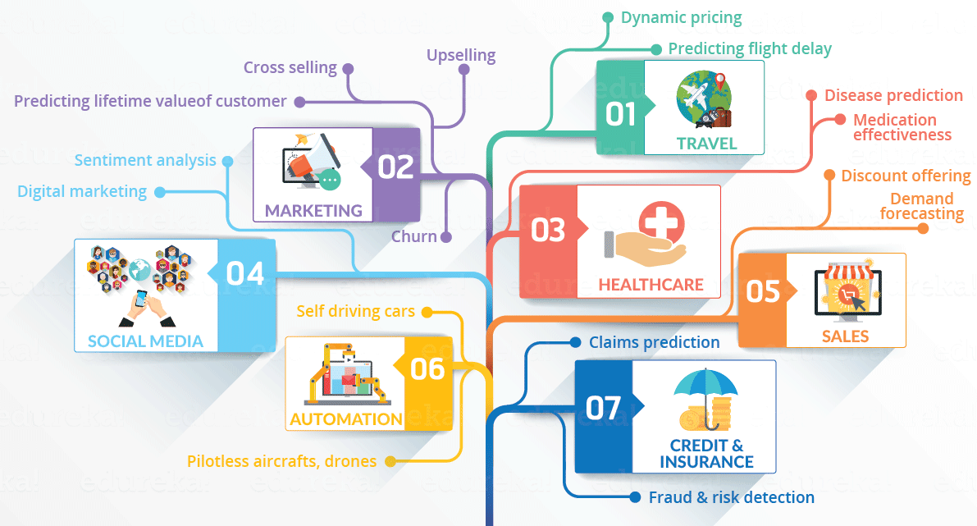
Unlocking Value From Data
Data science applications and examples

Slide 4

Unlocking Value From Data
Example: Predict Neonatal Infection
Problem: Children born prematurely are at high risk of developing Infections, many of which are not detected until after the baby is sick
Goal: Detect subtle patterns in the data that predicts infection before it occurs
Data: 16 vital signs (e.g., heart rate, respiration rate, blood pressure)
Task: Develop a predictive model using existing data and use the data from new children to predict the infection
Impact: Predict the start of infection 24 hours before traditional symptoms of infection appear
Predicting neonatal infections by evaluation of the gastric aspirate: a study in two hundred and seven patients

Slide 5
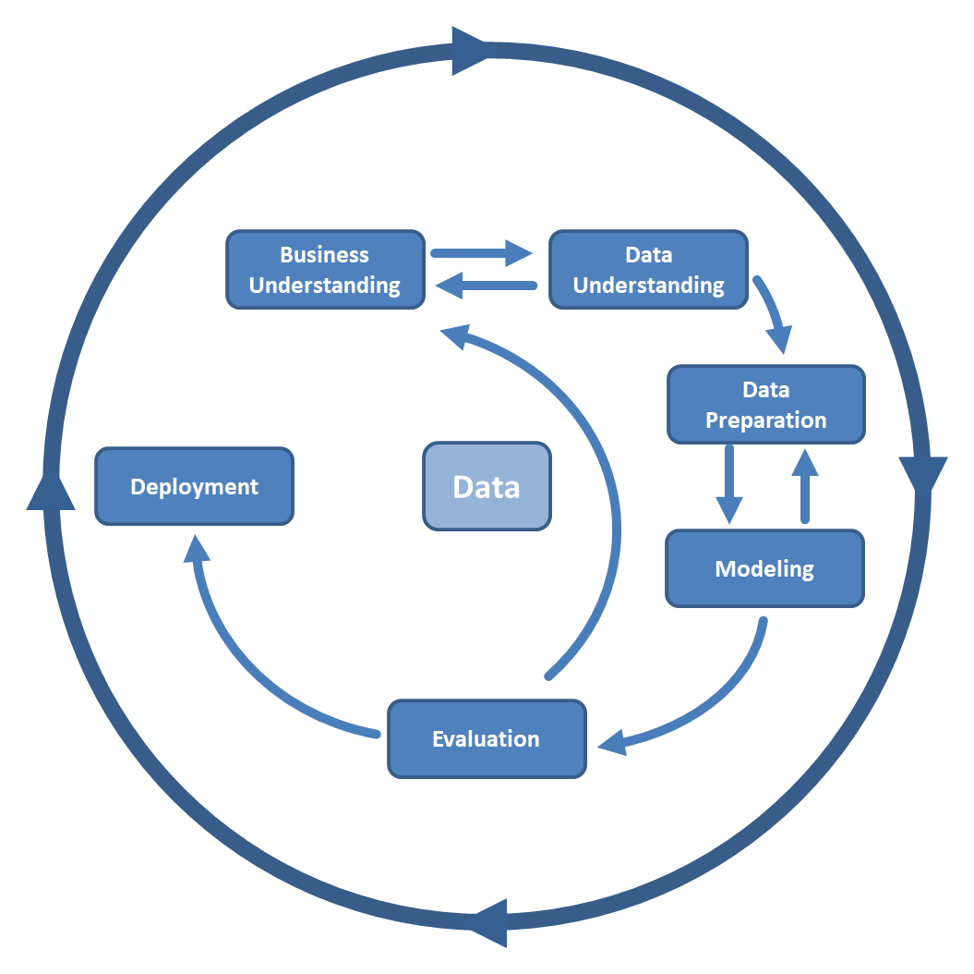
Lifecycle of a Data Science Project
CRISP-DM
Ask an interesting question/find a problem to tackle
What is the business objective/scientific goal?
How to collect data?
Which data is relevant/important for my problem?
What each data item (e.g., column) represents?
Are there missing values or corrupted records?
Are there any anomalies and patterns?
How should I plot the data?
What models should be built to enable decision-making or support?
Source: towardsdatascience.com
Do the results make sense?
What can we learn? Do we have a story?

Slide 6
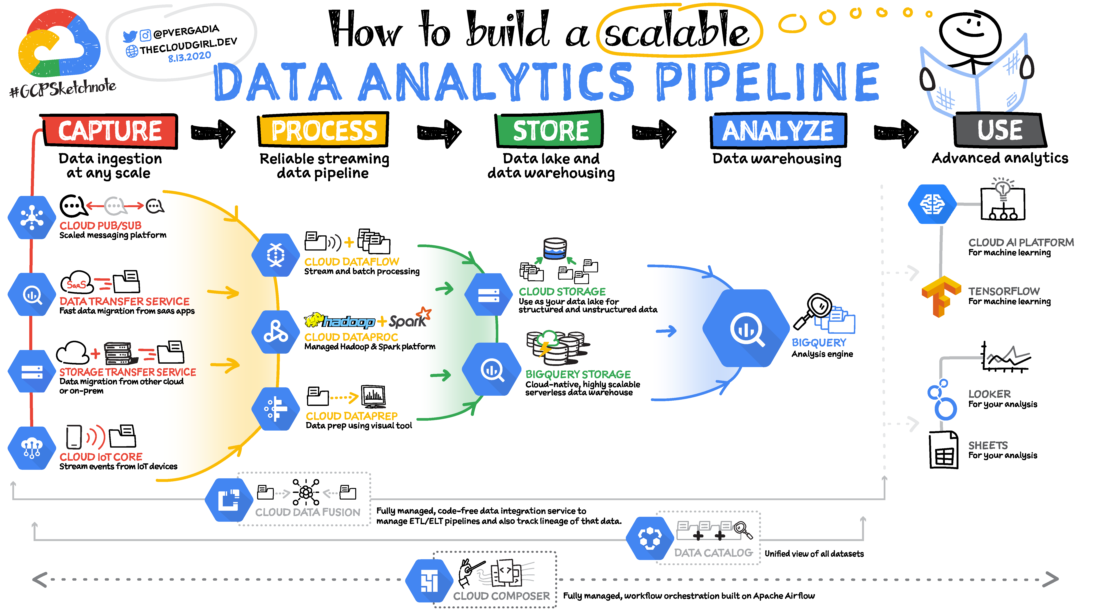
Data Pipeline
Source: peerdh.com

Slide 7
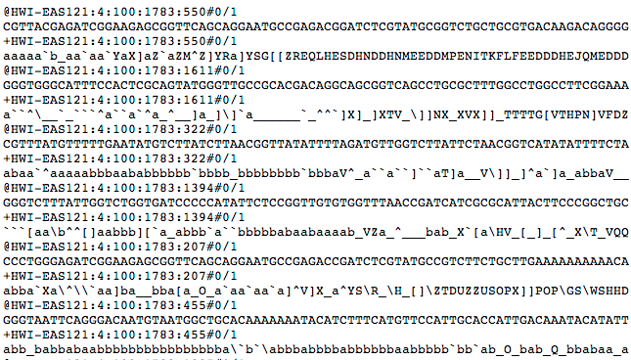
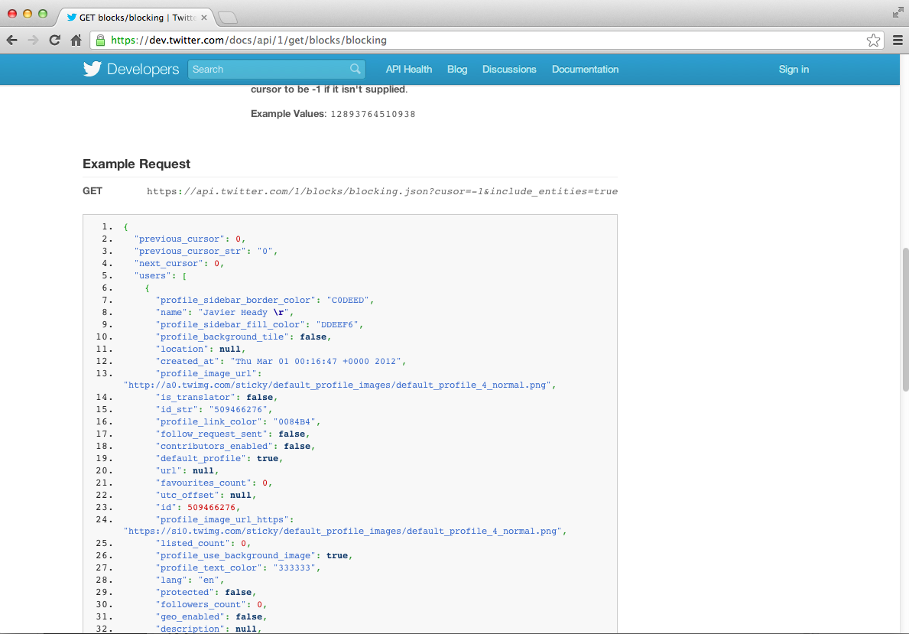
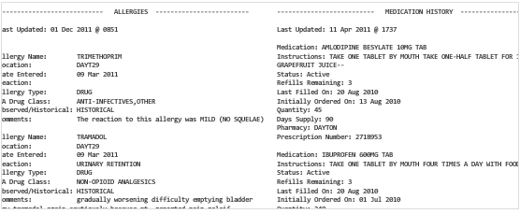

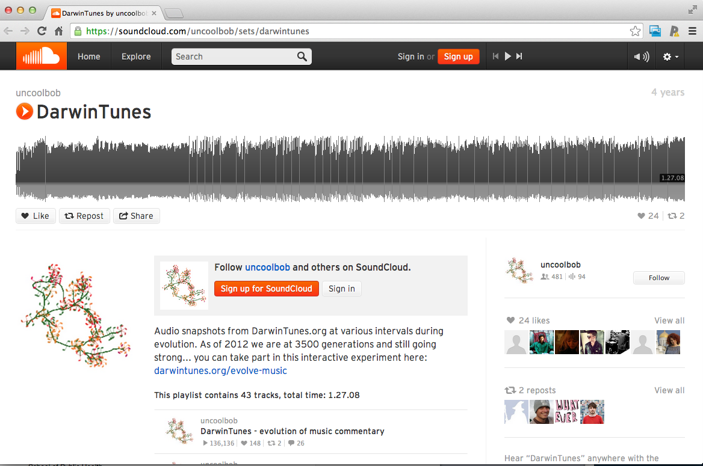
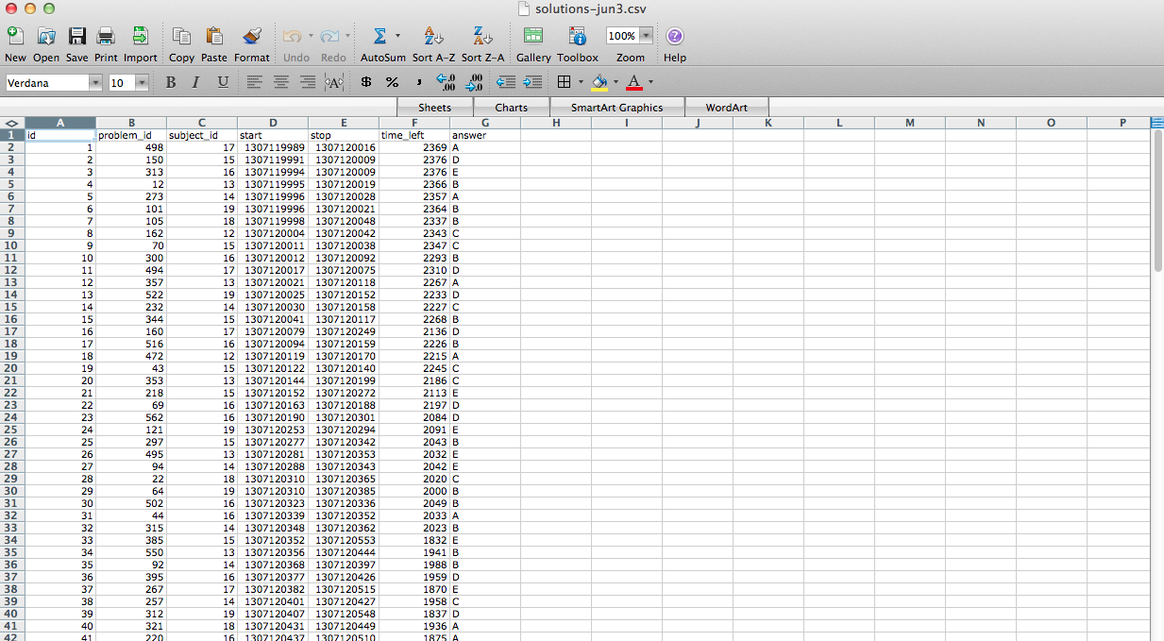
What do data look like?
Encoded data
Twitter data
Patient records
Images
Sound
Excel data

Slide 8




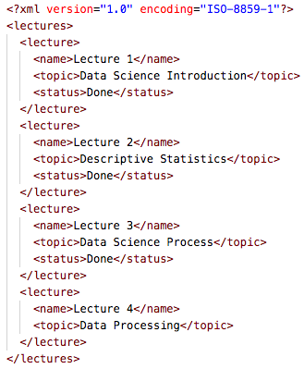







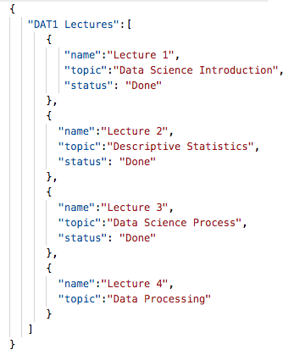
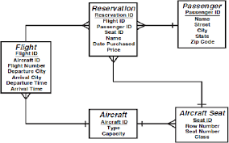



The Good, The Not-So-Bad and the Ugly
Structured data
Semi-structured data
Unstructured data

Slide 9

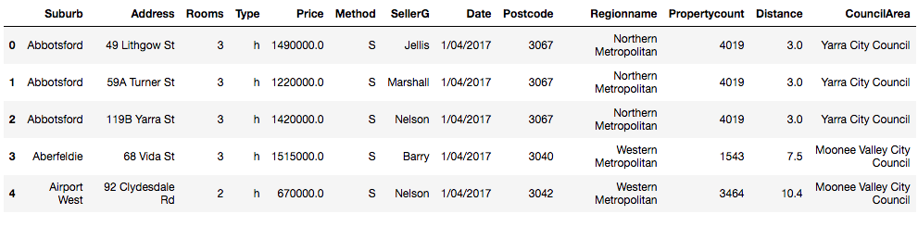
Melbourne Housing Market
Context: John and Jane Doe from York (UK) have been offered a great job as Senior Data Scientists at a big financial organisation in Melbourne (AU).
Problem: Before committing to such a life changing decision, the couple wants to examine the cost of living in Melbourne, given the continually increasing house prices.
Real data extracted by scraping the AU property site Domain.com.au
Detailed information for more than 34K entries - 21 variables: address, #rooms, price etc
https://en.wikipedia.org/wiki/Melbourne

Slide 10
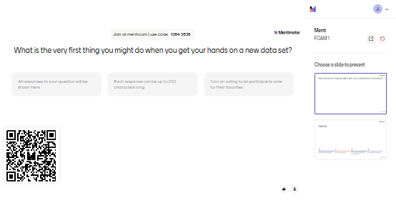
We have data. Now what?

Slide 11
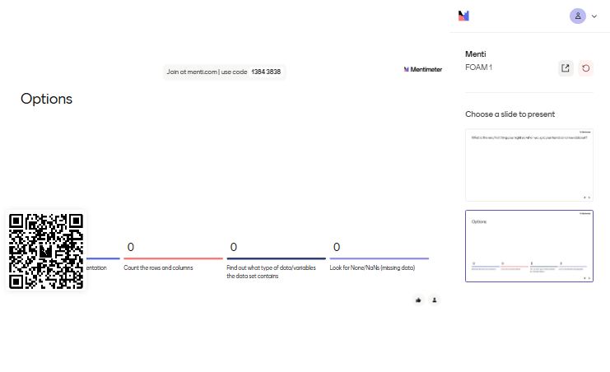
We have data. Now what?

Slide 12
Exploratory Data Analysis
Before making inferences from data…
it is essential to examine the variables of our dataset
Why?
To see patterns in the data
To identify and resolve mistakes
To find violations of statistical assumptions
To find how many observations/entries exist
To find the data types of my dependent/independent variables
To assess whether the data is relevant to the problem solved
…and because if you don’t, you will have trouble later!

Slide 13
Types of Data: NOIR
Categorical
Data is divided into groups
Numerical
Data represents numbers
Nominal No implied order among categories
Ordinal
Clear ordering/ranking between categories
Interval
Can be counted in a finite manner
Ratio
Can be measured not counted; infinite number of possibilities
e.g. gender; blood type;
property type (flat, detached) ;
house status (sold/available)
e.g. survey answers (fully agree – fully disagree); height interval scale; bug severity (low, medium, high)
e.g. number of heads in 100 coin flips; temperature in Celsuis (Centigrade) or Fahrenheit
e.g., dog height; house price; house distance from York centre; exact amount of gas purchased from petrol station

Slide 14
Descriptive Statistics
Descriptive Statistics
How often do the data points happen?
What are the common data points?
Where are the data points (wrt to each other)?
How does the spread of scores look like?
Frequency
Central tendency
Position
Variation/ Dispersion
Counts
Percents
Quartile rank
Percentile rank
Mean
Mode
Median
Variance
Standard deviation
Range

Slide 15
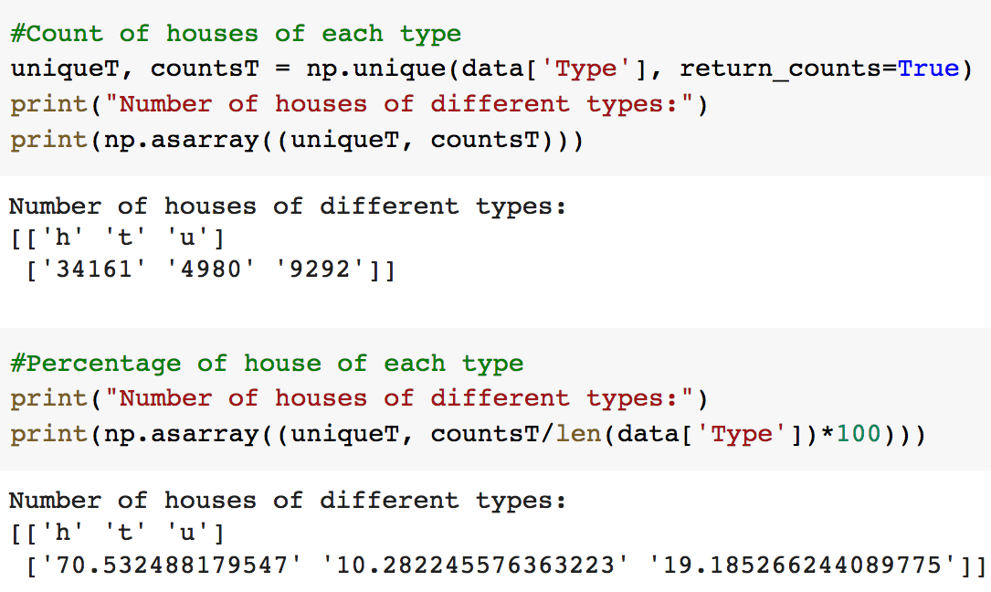
Frequency
Used with countable data, i.e., there are separate categories in which the subject can be and the number of entries in each category can be counted
Count: how many times an event has happened or happened within a given time frame
Percent: The percentage of a particular category over the sample size

Slide 16
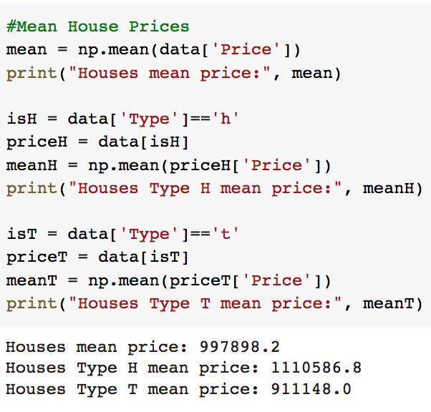
Mean
Captures the centre of the distribution
Help us understand our data
If the data sample is drawn from a population, the mean of the sample is an unbiased estimate of the population mean
For example, given the house values (in thousands) [70,60,80,85,92]
μ = (70+60+80+85+92)/5 = 77.4

Slide 17
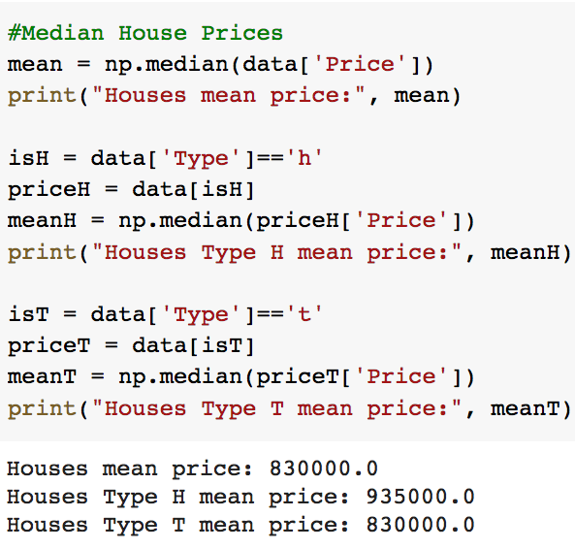
Median
The middle score in an ordered set of data
Odd number of observations ➔ find the middle value e.g., [30,45,67,87,94,102,124] Median = 87
Even number of observations ➔ find the middle two values and average them
e.g., [30,45,67,87,94,102,124,155] Median = (87+94)/2=90.5
The median minimises the sum of the absolute deviations
Notes:
Half of the members of the population have values higher than the median, and half have values lower.

Slide 18
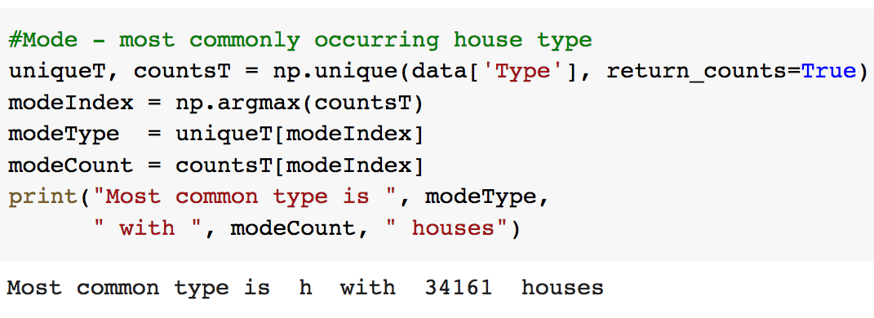
Mode
The most commonly occurring entry (with the highest frequency)
Represents the largest number of data with the same value in the sample
If a value appears repeatedly in the data, it will influence the average towards the modal value
Remember the frequency of type h?
70.53% (more than half of the available houses)

Slide 19
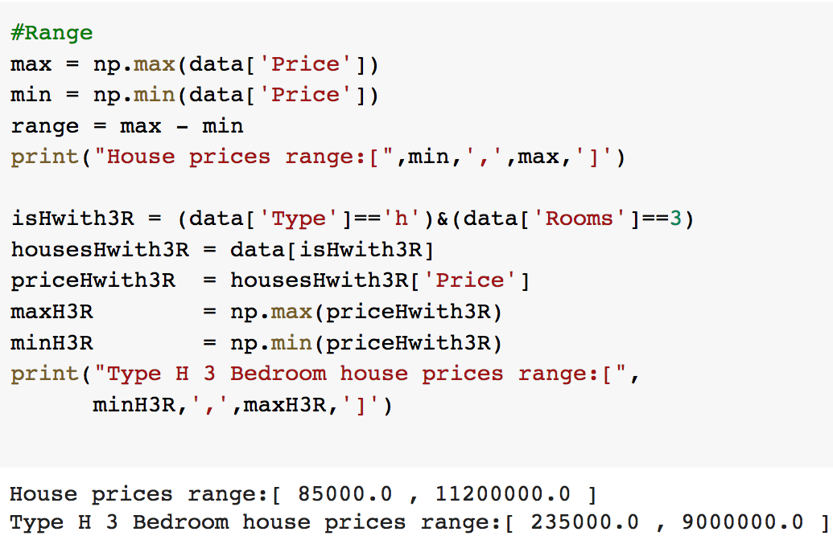
Range
Distance from the lowest to the highest value of the data
Suffers from total reliance to extreme values or outliers (unusually extreme values).
The price of 3 bedroom type H houses in Melbourne ranges from $235K to $9M!

Slide 20
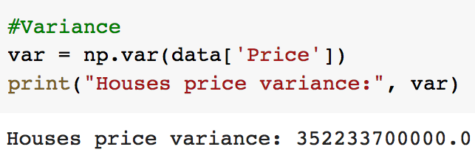
Variance
Calculates the deviation of the group from the mean.
The average sum of squared errors between the mean and the data (the observations)
Sample variance
Problem? The result is in units squared (e.g., £²) because we squared the error e.g. the average error in our Melbourne house data is £352 squared! No meaning!!

Slide 21
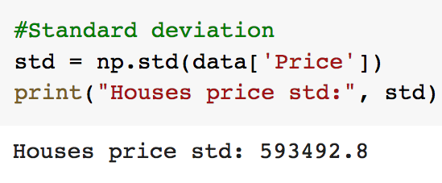
Standard Deviation
The square root of the variance.
The measure of average error is in the same units as the original measure
Sample standard deviation

Slide 22
Quartiles
Quartiles divide data into four equal regions
Lower quartile Q1 is the median of the first half
Middle quartile Q2 is the median
Upper quartile Q3 is the median of the second half
Consider the house values (in 100K) [60,70,80,85,92,101,125,150]
Q1: 75, Q2:88.5, Q3: 113
Interquartile range: Q3 – Q1
About 50% of data falls within the IQR
IQR is not affected by every value in the dataset
IQR is not affected by outliers
IQR
25%
25%
25%
25%
Q1
Q2
Q3

Slide 23
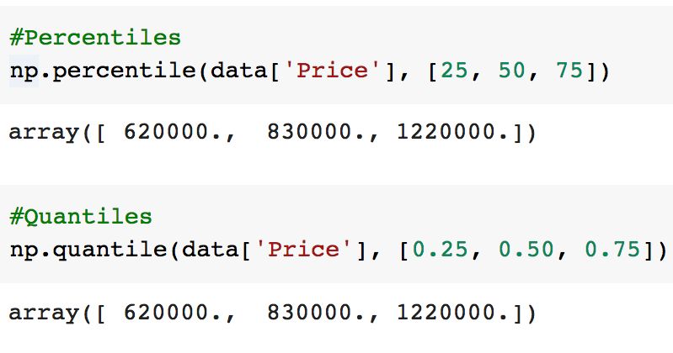
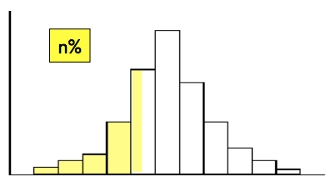
Percentiles (aka Quantiles)
The n^{th} percentile is a value such that n% of the data fall at or below or it
In which percentile does the house that the Does will buy fall at?
Q1: 25th percentile = 0.25 quantile
Median: 50th percentile = 0.50 quantile
Q3: 75th percentile=0.75 quantile
Note: Both NumPy methods have an optional interpolation parameter specifying the interpolation method to use {'linear', 'lower', 'higher', 'midpoint', 'nearest'} when the desired quantile lies between two data points.

Slide 24
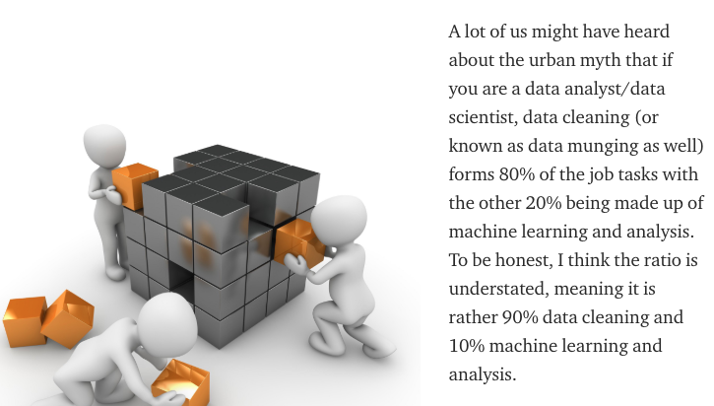
Do we really need Data Integrity?

Slide 25
Missing Data: Is it serious?
Well, it depends on:
The amount of missing data
- Given a variable (column), how much data is missing over the entire dataset?
The pattern(s) of missing data - Does the missing data exhibit any common characteristics?
The reasons why it is missing - Can I identify the reasons that caused the missing data?

Slide 26
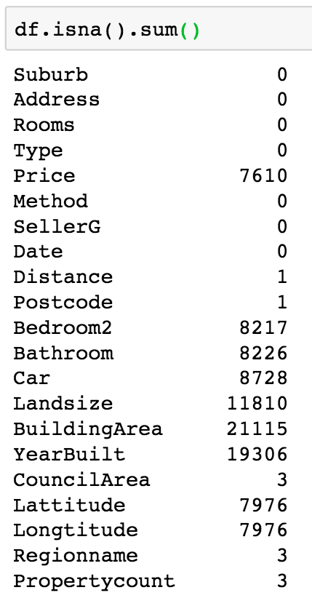
Missing data in Melbourne housing market dataset
Missing data in Melbourne housing market dataset
Variable | Description
Price | Property price (in AUS Dollars)
Distance | Distance from city centre in KMs
Postcode | (self-explanatory)
Bedroom2 | Number of bedrooms
Bathroom | Number of bathrooms
Car | Number of car parking spaces
Landsize | Land size in metres
BuldingArea | Building size in metres
YearBuilt | Year the house was built
CouncilArea | Governing Council for the property
Lattitude | (self-explanatory)
Longitude | (self-explanatory)
Regionname | General region of the property
Propertcount | Number of properties in the suburb

Slide 27
Missing Data: Possible Reasons
Solving the problem of missing data is possible only by finding the reasons for the appearance of missing data
A variable (question) might not apply to a specific record e.g. questions only asked to married respondents
Data source does not have this information e.g. independence days of countries around the world
A respondent fails to answer a question in a survey
The question is too difficult or complicated
Ignored by accident
They don’t want you to know

Slide 28
Missing Data: Types of Missing Data
Missing Completely at Random (MCAR) Missingness is purely random. The probability of a data point being missing is unrelated to both the value of the variable itself and the value of any other variable in the dataset.
Missing at Random (MAR) You can predict why a value is missing using the data you do have. Is the most common and often the most manageable type of missing data. The probability of a value being missing depends on other observed variables in the dataset, but not on the missing value itself.
Missing Not at Random (MNAR) Is the most difficult type. The probability of a value being missing depends on the value of the missing variable itself or on an external factor not in the dataset.

Slide 29
Missing Data: Why Not To Ignore?
Missing data can lead to dubious results e.g., find the mean price of properties in Melbourne (with missing values); what is 1.48m + NA?
Many machine learning algorithms do not work with variables (features) having missing values e.g. try running a Deep Neural Network with missing data
May introduce bias e.g. linear regression model might result in discriminative behaviour
More laborious processing

Slide 30
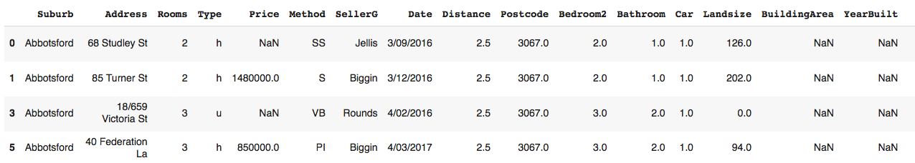
Handling Missing Data
Information not available for a subject about whom other information exists
A Data Science project is only as good as its data
The datasets you used so far were cleaned!
Missing data termed NaN, Null or NA
General process for handling missing data
Understand data, identify reasons for missing data
Understand distribution/patterns of missing data
Decide on best recovery method

Slide 31
When Should A Variable Be Excluded?
Missing data in Melbourne housing market dataset
No strict rule about how much missing data for a variable is too much!
Rule of thumb: Missing data under 20% for an individual variable (observation) can generally be handled by sophisticated imputation strategies
Except when the missing data occur in a specific non-random manner e.g. Respondents completing the survey on Friday afternoon do not answer the last two questions
The number of records with no missing data must be sufficient for the selected analysis technique if no recovery method is applied to missing data

Slide 32
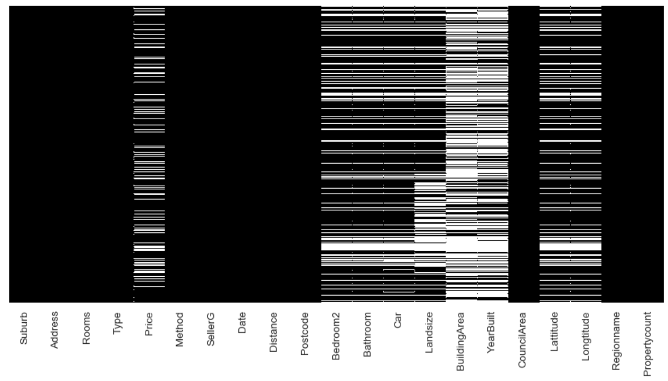
When Should A Variable Be Excluded?
Visualised missing data for the Melbourne housing market dataset white stripe ➔ missing data item

Slide 33
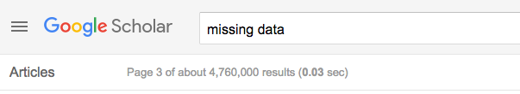
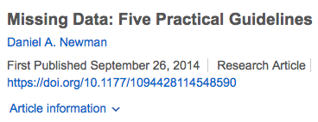

How to Deal With Missing Data?
More than 4M results in Google scholar (link)
Handling missing data is a very complicated subject
Strategies range from simple and straightforward to sophisticated and complex
Papers to read (on VLE)

Slide 34
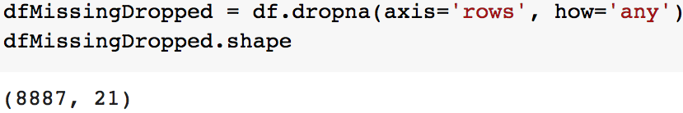
List-wise Deletion
Drop records with at least one missing data item
Only analyse records with data available for all variables
Records containing missing variables are deleted
Rule of thumb – only an option if comprise less than 5% of overall records and data re MCAR.
Advantages
Simplicity
Comparability across analysis
Disadvantages
Reduces statistical power (fewer records)
Melbourne dataset has 9K entries (instead of the original 34K )
Doesn’t use all information
Results may be biased if missing data is not MCAR!

Slide 35
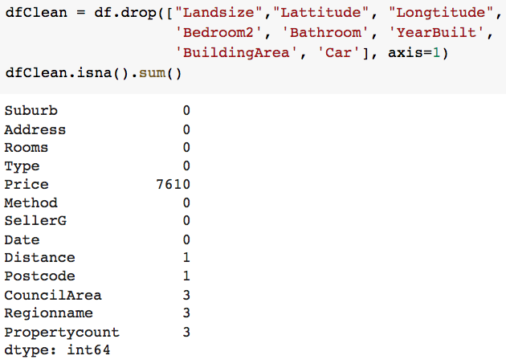
Variable Elimination
Drop variables (columns) with many data missing
If too many data is missing for a variable we can remove it from the dataset
No strict rule when this should happen, proper data analysis is needed
Advantages
Simplicity, easy to implement
Effect is easily understandable
Disadvantages
If done blindly, it may affect the results of analysis

Slide 36
Variable Elimination
Drop variables (columns) for other reasons
If it is a predictor (independent) variable and it is highly correlated with another variable,
If the variable is nearly constant i.e. almost all of the values are the same (~99%)

Slide 37
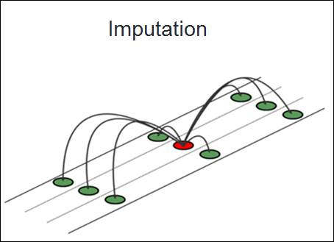
Imputation Strategies
Imputation: Insert a value into data in a “fabricated manner”
Handle missing values by substituting them with an approximation inferred from the value of the products to which it contributes.
Single Imputation Strategies
Mean/Median/Mode imputation
Dummy variable control
Hot/Cold deck imputation
and many more (see papers)
Model-Based Imputation Strategies
Regression
Multiple imputation
and many more (see papers)
https://en.wikibooks.org/wiki/Travel_Time_Reliability_Reference_Manual/Imputing_Missing_Speed_Data

Slide 38
Mean/Median/Mode Imputation
Calculate mean/median/mode of the non-missing values in a column
Replace the missing values within each column separately and independently from the others
Run analysis as if all complete cases
Advantages
Easy and fast
Works well with small numerical datasets
Disadvantages
Introduces too much bias and artificially lowers variability of data
Ignores relationship between variables ➔ weakens correlations between variables (works only on the column level)

Slide 39
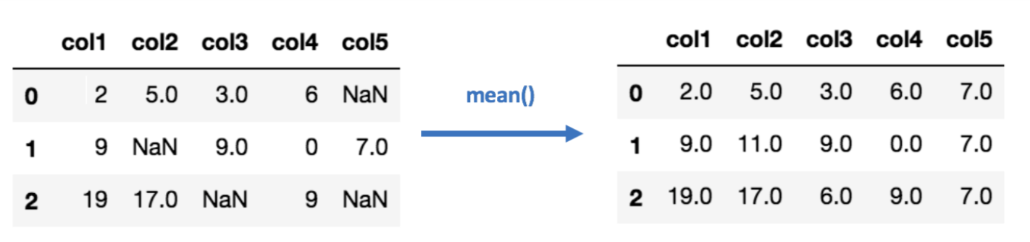
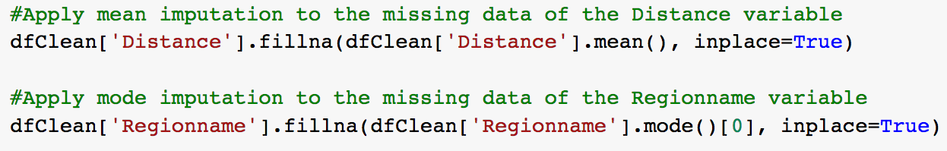
Mean/Median/Mode Imputation
Example: Mean imputation
Pandas command: Numeric (top) & Categorical (bottom)

Slide 40
Dummy Variable Adjustment
Create an indicator variable for missing values (per variable or in total)
1=value is missing; 0=value is observed for the record
Impute missing values to a constant (e.g. mean, median)
Advantage
Uses all available information about a missing record
Disadvantage
Can result in biased estimates

Slide 41
Dummy Variable Adjustment
Some properties have missing BuildingArea values. If we just delete these rows, we lose valuable data. If we put in zero, it would be wrong (no building has zero area).
Use the median BuildingArea to fill missing values.
Why the median?
The median is robust to outliers (unlike the mean)
If we have a few mansions with huge areas, they won't skew our imputation
It represents the "typical" building size in our dataset
Create Dummy Variables
For Property Type (Type): We have 3 categories: h (house), u (unit), t (townhouse)
We create 2 dummy variables: Type_u = 1 if unit, 0 otherwise Type_t = 1 if townhouse, 0 otherwise (Type_h) Houses become our reference category
Price = β₀ + β₁×BuildingArea + β₂×Type_u + β₃×Type_t

Slide 42
Hot/Cold Deck Imputation
Replace missing data with actual values from the most similar record or best known value
Hot Deck Imputation
Find all the sample records which are similar to other variables, then randomly choose one of their values to fill in the missing data
Cold Deck Imputation
Systematically choose the value from a record with similar values to other variables (e.g. the third item of each collection)
Advantage
Constrained by pre-existing values
Disadvantage
Missing data process indicates variables to use for similarity extraction
Must define appropriate best known values

Slide 43
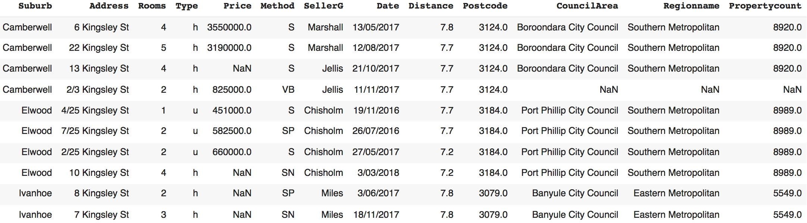
Hot/Cold Deck Imputation
Example: Cold Deck Imputation for property at 2/3 Kingsley St (yellow shaded)
Three other properties belong to the same suburb (orange shaded)
Exploit the spatial relationship of properties in this dataset
Impute ‘CouncilArea’, ‘Regionname’ and ‘PropertyCount’ using information from those properties

Slide 44
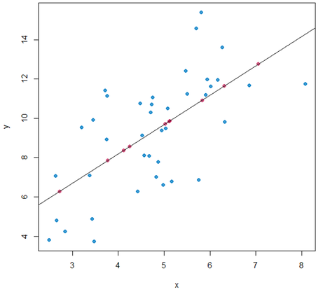
Regression Imputation
The imputed value is predicted from a regression equation based on other dataset variables (regression will be covered next week)
Advantages
Uses information from observed data
Preserves relationships among variables in the imputation model
Disadvantage
Limited variability around predicted values
Overestimates model fit and correlation estimate
Requires sufficient relationships among variables to generate valid predicted values

Slide 45
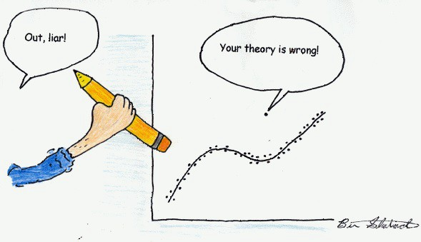
Outliers: What are they?
Data (records) significantly different from the majority of data within the dataset (or population)
They are rare, or distinct, or do not fit in some way with the dataset
Examples:
A student’s average mark is over 95% while the rest of the class is around 70%
Within the bank transactions of a customer there is an entry 10 times larger than most of their transactions
The house price of 3 houses in York is over £5m while the average price is around £500K

Slide 46
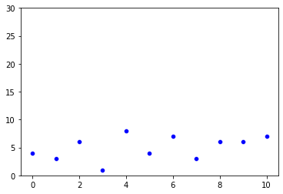
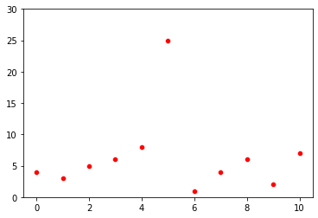
Outliers: What are they?
 | Without Outlier | With Outlier
Values | [4, 3, 6, 1, 8, 4, 7, 3, 6, 6, 7] | [4, 3, 6, 1, 8, 26, 7, 3, 6, 6, 7]
Mean | 55/11 = 5 | 77/11 = 7
Median | 6 | 6
Mode | 6 | 6
Std | 2.045 | 6.34

Slide 47
Outliers: Where do they come from?
Data entry errors: Human errors caused during data collection or recording e.g. While trying to pay your utility bills online you do not add the decimal place and pay £5000 for your water bill instead of £50,00
Measurement errors: The measurement instrument is faulty e.g. a temperature sensor on Raspberry Pi produces wrong values
Intentional: Unwillingness to disclose information, hence inputting false information in forms e.g. Teens might under report the amount of alcohol they consume
Data Processing Error: Data extraction or manipulation (while doing data science) may lead to outliers in the dataset.
Natural Outlier: A genuine outlier e.g. Michael Jordan (basketball), Usain Bolt (record breaking sprints)

Slide 48
Outliers: What is their impact?
Outliers can have significant impact on the results of our data science project (data analysis and statistical modeling)
They can introduce bias or influence estimates of significant interest
Machine learning algorithms are sensitive to provided data (the range and distribution of data)
Outliers can adversely affect the training process
They can increase significantly training times, produce less accurate models and poorer results
Outliers ARE NOT ALWAYS BAD
Anomalies in heartbeat data can help in predicting heart diseases
Anomalies in traffic patterns can help in predicting accidents
Hence, it is important to detect and understand the origin of outliers!

Slide 49
Outliers: How to detect them?
No precise way to identify outliers; they are specific to each dataset!
Data scientists must interpret the raw data and decide whether an outlier exists or not
Help?
We can use statistical methods to identify records that appear to be unlikely given the data available
This does not mean that the values identified are outliers and should be removed
These are rare events that deserve/require a closer second look!

Slide 50
Outlier Detection Using IQR
IQR
Measures the variability of data considering the range covered by the MIDDLE 50% of the data
A record (x) is a suspected outlier if:
x > upperFence, where upperFence = Q3 + k* (IQR)
x < lowerFence, where lowerFence = Q1 - k *(IQR)
with IQR = Q3 – Q1, k ≥ 0 (typically, k=1.5)
Outlier
Outlier
IQR
25%
25%
25%
25%
k* IQR
k* IQR
Q1
(Lower quartile)
Q2
(Median)
Q3
(Upper quartile)
Lower fence
Upper fence

Slide 51
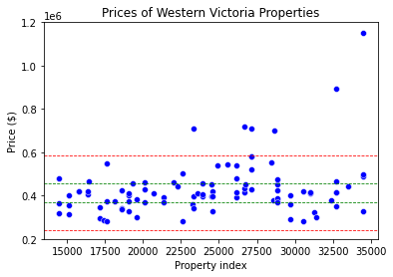
Outlier Detection Using IQR
The couple decides to investigate the properties in the Western Victoria region
Outliers
Upper fence Q1 + 1.5*IQR
587500
Q3
457000
Q1
370000
Lower fence Q1 – 1.5*IQR
239500

Slide 52
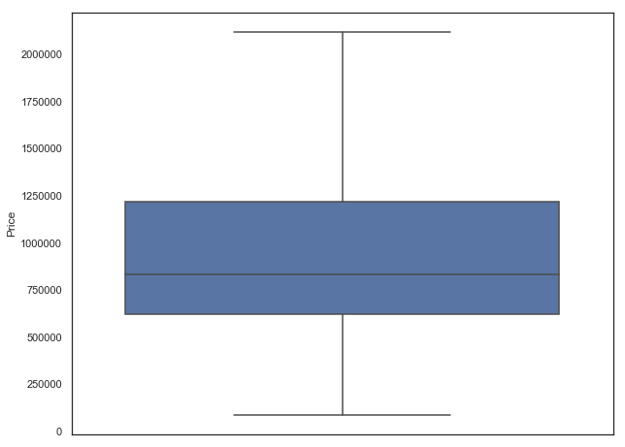
Outlier Detection Using Boxplots
Melbourne housing market (without outliers)
Upper whisker
Upper quartile – Q3
Median
Lower quartile – Q1
Lower whisker
Notes:
What do

Slide 53
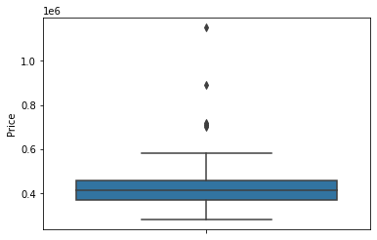
Outlier Detection Using Boxplots
Melbourne housing market (with outliers)
Outliers
Upper whisker
Upper quartile – Q3
Median
What information do they convey? (symmetric data, variability)
Lower quartile – Q1
Lower whisker
Notes:
What do

Slide 54
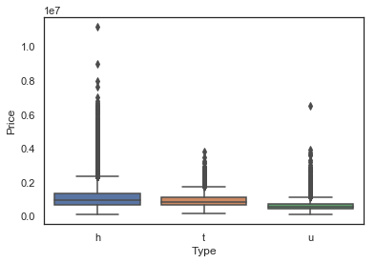
Outlier Detection Using Boxplots
Melbourne housing market per property type
Notes:
What do

Slide 55
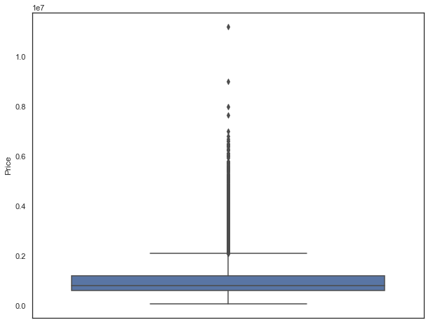
Boxplot Construction
Recipe
Given a dataset, find the median, Q1 and Q3
Draw a horizontal line for the median (Q2)
Draw a horizontal line for the upper and lower quartiles (Q1, Q3)
Connect these quartiles into a box
Find the upper and lower fences (e.g., using the IQR method)
Draw a horizontal line for the lowest and largest values within the fences
Connect them to the box with whiskers
Add the outliers using another shape
Notes:
What do

Slide 56
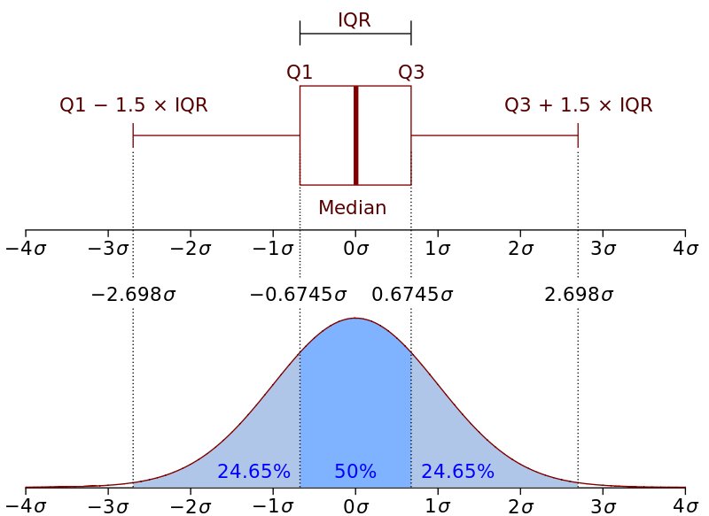
Outlier Detection Using Std
If the data distribution in the dataset is Gaussian-like, we can use the standard deviation of the sample as a cut-off for identifying outliers
1 Standard Deviation from the Mean: 68%
2 Standard Deviations from the Mean: 95%
3 Standard Deviations from the Mean: 99.7%
A value that falls outside of 3 standard deviations, is an unlikely or rare event
Use this rule of thumb as a cut-off for identifying outliers
For our case study, this detection strategy returns the two most expensive properties as outliers

Slide 57
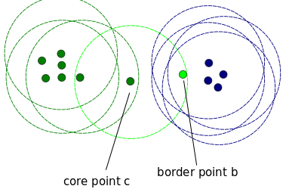
Other Methods For Outlier Detection
Clustering Algorithms
Cluster data into groups
Can be also used for anomaly detection with single or multi-dimensional data
Depends on the required number of neighbours, the distance and the selected distance measure between clusters
Isolation Forest
Data partitioning done using a set of trees
An anomaly score is given depending on how isolated the point is in the structure
The score is used to identify outliers from normal observations
and many others!
https://scikit-learn.org/stable/auto_examples/plot_anomaly_comparison.html

Slide 58
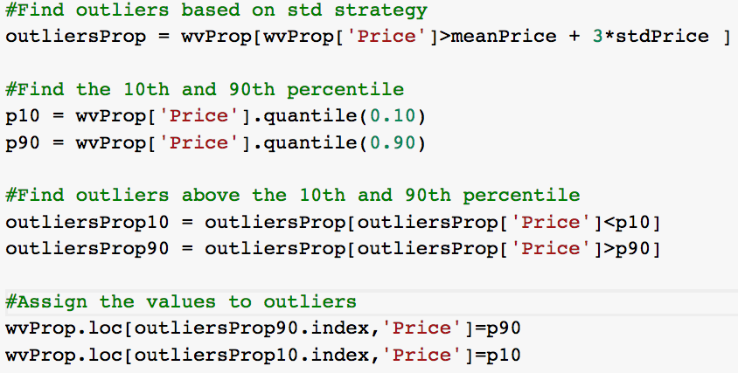
Outliers: How to treat them?
Difficult decision: should you remove or correct outliers?
Option 1: Drop outliers
If they occur due to data entry error, data processing error
If outliers are very small in numbers
Option 2: Quantile-based Flooring and Capping
Assign the lower values to the 10th percentile (floor)
Assign the higher values to the 90th percentile (cap)
FOAM
58

Slide 59
Outliers: How to treat them?
Option 3: Apply imputation methods (Similarly to missing data)
Median, Hot/Cold deck imputation, Regression
Option 4: Log transformation
Transformation reduces the variation caused by extreme values
Logarithmic (most common), square root, or square transformations
FOAM

Slide 60
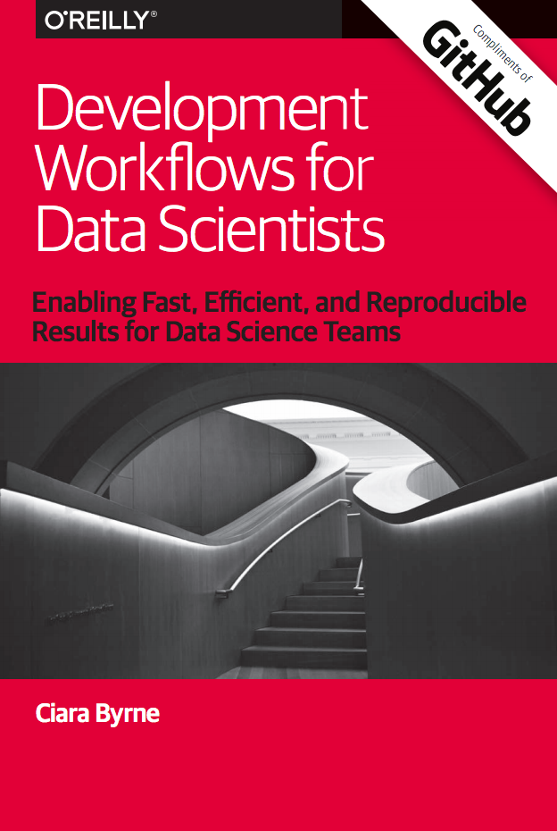
Further reading
Development Workflows for Data Scientists
Enabling Fast, Efficient, and Reproducible Results for Data Science Teams
Available online at: https://resources.github.com/downloads/development-workflows-data-scientists.pdf
OSEMN Process
http://www.dataists.com/2010/09/a-taxonomy-of-data-science
The Team Data Science Process by Microsoft
https://docs.microsoft.com/en-us/azure/machine-learning/team-data-science-process/overview
The Data Science Workflow at BinaryEdge
https://blog.binaryedge.io/2015/09/08/the-data-science-workflow
FOAM

Slide 61
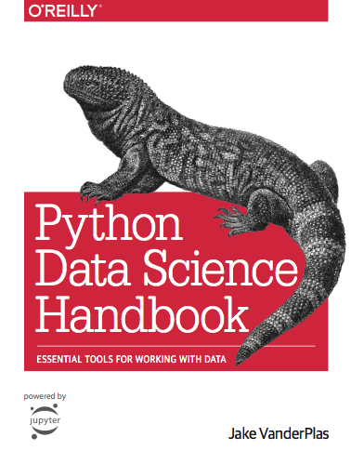
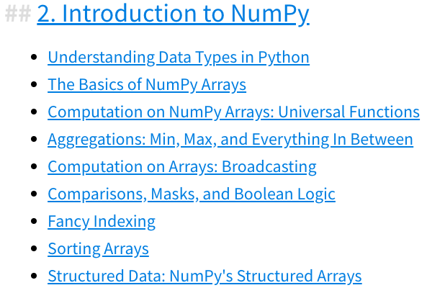


Practical Essentials
Python Data Science Handbook (Reading list)
Available online https://jakevdp.github.io/PythonDataScienceHandbook
Official Seaborn Tutorial https://seaborn.pydata.org/tutorial.html
FOAM

Slide 62

Jupyter Notebook
https://jupyter-notebook.readthedocs.io/en/stable/
A powerful tool for interactively developing and presenting data science projects
A notebook is a single document where you can
write and run code, view the output
add text, explanations, formulas, charts, etc
explain your data science results and share them
We will be using it for writing Python and Markdown (an easy to learn markup language for formatting plain text)
On VLE, there is a tutorial on how to install Jupyter on your machine
FOAM

Slide 63
Summary
Data Science Lifecycle
Exploratory Data Analysis
Handling Missing Data
Identifying and Handling Outliers
FOAM

